Slide 1
Clique Cover Problem
Approximate Algorithms
Group No: 10
Student ID:
1505002
1505044
1505057
1505097
1505101

Slide 2
Polynomial-Time Approximation Scheme
If there is a polynomial-time 𝛅-approximation algorithm with 𝛅 = 1 + ε, for any fixed value ε > 0 to solve a problem, then the problem is said to have a polynomial-time approximation scheme (PTAS)

Slide 3
Clique Cover does not admit a polynomial time approximation scheme unless P=NP [ Lund and Yannakakis,1994]
It follows from known reductions from the Graph Coloring Problem [ Simon 1990]

Slide 4
Clique Cover admits a PTAS for Planar Graphs
[Munaro A. 2017]

Slide 5
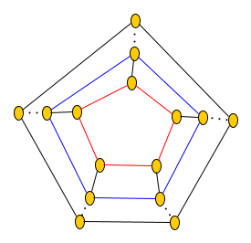
Notations
G : a planar graph
L_{i} : the i-th layer of G
N(v_{i}) : neighbors of the vertex v_{i}
V(G) : all vertices of G
Q : minimum size clique cover of G
G_{ij} : subgraph of G where layer indices are between
(j-1)(k-1)+i and j(k-1)+i inclusively

Slide 6

K-outerplanar graph : k-outerplanar graph is a planar graph that has a planar embedding in which the vertices belong to at most k concentric layers.
Clique Cover can be solved in polynomial time for
k-outerplanar graphs. [ M.Rao,2017]

Slide 7
Proof
Here, v_{i} ϵ L_{i} and N(v_{i}) ϵ L_{i-1} ∪ L_{i} ∪ L_{i+1}
Suppose, k=⌈2/ε⌉ ,for a given ε>0
G_{ij} is a k-outerplanar graph, for 1≤ i ≤ k and j ≥ 1
We can set, C_{i} = ⋃_{j>0} C_{ij}
Again, ⋃_{j>0}V(G_{ij}) = V(G)
We will take one with minimum size from all possible C_{i}

Slide 8
Let, Q_{i} ϵ Q where Q_{i} contains at least one vertex
in ⋃_{j=i mod k}L_{j}
As, ⋃Q_{i} = Q, it can be said,
❘Q_{l}❘ ≤ 2/k ❘Q❘ ≤ ε❘Q❘
Let, Q_{lj} ϵ Q where Q_{lj} contains at least one vertex
in V(G_{ij})
For each j>0, ❘C_{lj}❘ ≤ ❘Q_{lj}❘ and ⅀❘Q_{lj}❘ = ❘Q❘ + ❘Q_{l}❘

Slide 9
Finally,
❘C_{l}❘ ≤ ⅀❘C_{lj}❘ ≤ ⅀❘Q_{lj}❘
= ❘Q❘ + ❘Q_{l}❘
= ❘Q❘ + ε❘Q❘
= (1+ε)❘Q❘

Slide 10
Approximation Algorithm
In this section, we present approximation algorithms for the k-clique covering problem. We first examine the problem on graphs for the cases k 4 and then for arbitrary k.
All vertices that are not isolated get covered when all edges are covered. Only isolated vertices may require additional cliques to be covered. For simplicity’s sake, we are going to present the algorithms for covering edges only.

Slide 11
Notations
We use the common notation for a graph G (V, E)
IVl = n and IEI = m.
In case G has isolated vertices, m denotes the number of edges and isolated vertices.

Slide 12
Approximation Algorithm for Cubic Graph
Input: A K₄ free graph G(V,E) with maximum degree 3
Output: A partition into cliques for V with size at most 5/4 of OPT(G).

Slide 13
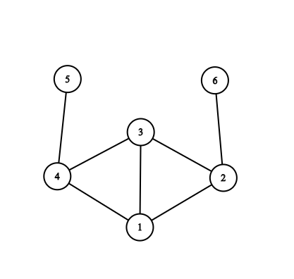
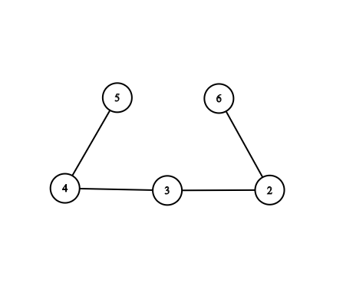
Definitions
K₃ is called triangle, K₄- e is called a diamond where e is an edge.
T is denoted as the collection of all triangles in G(V,E), Z_{T} is V\V(T) and M_{ZT} is the maximum matching of subgraph Z_{T}
Opening a Diamond:
(Remove either 1 or 3)

Slide 14
Lemma 1
Denote open(G) as a subgraph of G such that all diamond of G is opened.
OPT( open(G) ) = OPT(G)

Slide 15
Proof of lemma 1
OPT( open(G) ) <= OPT(G) because open(G) is a subgraph of G
OPT(open(G)) >= OPT(G) because we can add vertex 1 to the clique containing vertex 2 in a partition into cliques for open(G) in order to obtain a partition into cliques with same size for G

Slide 16
OPT(open(G)) = { {4,5}, {2,3}, {6} }
Insert vertex 1 in the clique with vertex 2 thus getting the same size solution for G
OPT(G) = { {4,5}, {1,2,3}, {6} }

Slide 17
Algorithm for Cubic graph
Update G by opening all diamonds of G
Set A₁ as the partition defined the collection T of triangles of G plus the edges of M_{TZ} plus the remaining |Z_{T}| - 2|M_{TZ}| vertices. Note that
|A₁| = |T| + |Z_{T}| - |M_{TZ}|.
Set A₂ as the partition defined by the edges of M_{G}, plus the remaining |V| - 2*|M_{G}| vertices. Note that, |A₂| = |V| - |M_{G}|

Slide 18
Algorithm for Cubic graph (Continue)
Update A₁ and A₂ with the diamond conversion rule of open(G) to G
Choose SOL(G) = A_{i} where A_{i} = min(|A₁|, |A₂|)

Slide 19
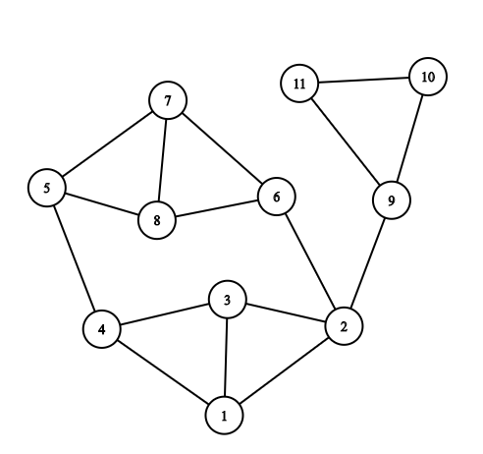
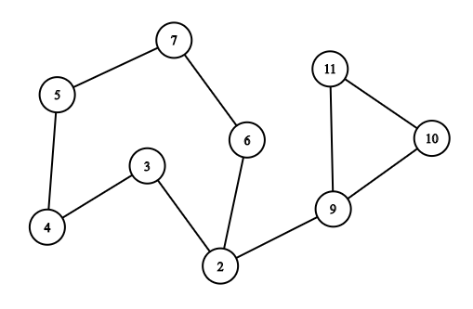
Fig: G Fig: open(G)
Now A1 = { {9,10,11}, {2,6}, {5,7}, {3,4} }. With diamond updated,
A1 = { {9,10,11}, {2,6}, {5, 7, 8}, {1, 3, 4} }.
A2 = { {9,10}, {2,6}, {5,7}, {3,4}, {11} }. With diamond updated,
A2 = { {9,10}, {2,6}, {5,7, 8}, {1, 3,4}, {11} }
Since |A1| < |A2|. We output A1 as the final partition.

Slide 20
Proof of Approximation Ratio
The performance ratio of the algorithm A is at most 5/4.

Slide 21
Proof(Continue)
Assuming, Z = Z_{T}
|OPT_{PIC}(G)| > |T| + ⅔ |Z| - ⅓ |M_{Z}| ……………………………………...Theorem.9
|A(G)| < |T| + |Z| - |M_{z}|
Considering two cases: |T| ≥ ⅔|Z|- ⅓|M_{Z}| or |T| < ⅔|Z|- ⅓|M_{Z}|
1) If |T| ≥ ⅔|Z|- ⅓|M_{Z}| then performance ration,
R_{A} = |A(G)| / |OPT_{PIC}(G)|
≤ (|T| + |Z| - |M_{z}|) / (|T| + ⅔ |Z| - ⅓ |M_{Z}|)
≤ 5/4
Iff 12|T |+12|Z|-12|M_{z}| ≤ 15|T |+10|Z|-5|M_{z}|
⇔ |T| ≥ (2/3) |Z|- (7/3) |M_{Z}|
But, |T| ≥ ⅔ |Z|- ⅓ |M_{Z}| ≥ ⅔ |Z|- ⅓ |M_{Z}| - (6/3) |M_{Z}| = (2/3) |Z|- (7/3) |M_{Z}|

Slide 22
Proof(Continue)
2) If |T| < ⅔ |Z| - ⅓ |M_{Z}| then we have two additional cases, |T*| ≤ |T|/2 and |T*| > |T|/2
In both case we prove that α is within |T|/2
If |T*| ≤ |T|/2 , new partition β ,
|A₂| ≤ |β|
= |α| + |T*|
= (|T*| + |Z_{T∗}| - |M_{ZT∗}|) + |T∗|
≤ (|T∗| + |Z_{T∗}| - |M_{ZT∗}|) + |T|/2
If |T*| > |T|/2 , β by adding to α all triangles of T - T*
|A₁| ≤ |β| where,|β| = (|T∗| + |Z_{T∗}| - |M_{ZT∗} |) + |T - T*|
≤ (|T∗| + |Z_{T∗}| - |M_{ZT∗} |) + |T - T*|
< (|T∗| + |Z_{T∗}| - |M_{ZT∗}|) + |T|/2

Slide 23
Proof(Continue)
Hence, in either case, α is within |T|/2 of A(G) ,
R_{A} = |A(G)| / |OPT_{PIC}(G)|
≤ (|T|/2 + |OPT_{PIC}(G)|) / |OPT_{PIC}(G)|
< 5/4 iff |T | < |OPT_{PIC}(G)| / 2
⇔ 2 |T| < |OPT_{PIC}(G)|

Slide 24

Approximation Algorithm for k-Clique Cover
We present a linear time k-approximation algorithm (H) for the k-clique covering problem.
Algorithm (H) finds a cover with star-shaped components. Phase 1 of (H) finds a sequence of vertices and edges, such that each edge and each vertex occurs once, and such that all edges in the sequence between consecutive vertices V_{i} and V_{i+1} are incident with V. The isolated vertices are appended at the end of this sequence.
In phase 2 the sequence is broken into batches of size at most k- 1. Such a batch of k- 1 edges and vertices induces a graph on at most k vertices, and forms a clique.

Slide 25
Approximation Algorithm for k-Clique Cover
ALGORITHM (H).
Input: Graph G = (V, E).
Phase 1: Set SEQ = ∅, V̅= V, E̅ = E
while V̅≠ ∅ do begin
Select a vertex v ∈ V̅
Set SEQ = (SEQ ,{v})
repeat
Find a vertex u ∈ V \ V̅ such that (u, v)∈ E̅
Set SEQ = (SEQ ,{u, v});
E̅ ← E̅ \ {(u,v)};
until no such u can be found;
end

Slide 26
Approximation Algorithm for k-Clique Cover
Let SEQ = S1,S2,...,S_{N}, where N =IEl + IVl
Phase 2: Set C^{H} = ∅, k̅ = 0
while k̅ < N do begin
Let C denote the component with vertex set V(C) = S_{k̅+1} ∪ … S_{k̅+k-1} and edge set E(C) = {S_{k̅+1},..., S_{k̅+k-1} } ∩E;
C^{H} ← C^{H} ∪ C
k̅ = k̅ + k -1
End
Output z_{H} = IC^{H}I as the number of cliques used by the algorithm
End of (H).

Slide 27

Complexity
THEOREM : (H) is a linear time -approximation algorithm.
Proof. Phase 1 can be realized in linear time by a simple breadth-first search. Phase 2 is obviously linear in the length of the sequence, O(m).
Let z^{H} be the number of cliques used for covering edges by heuristic (H), and let z* be the number used by an optimal clique covering. Let w denote the number of isolated vertices, V the set of non-isolated vertices, and E the set of edges. Then,

Slide 28


Complexity
THEOREM : (H) is a linear time -approximation algorithm.
and,
as each vertex v of degree δ(v) occurs in at least
cliques.

Slide 29

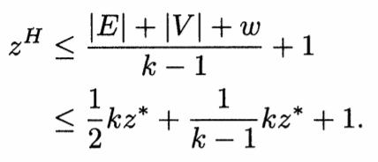
Complexity
THEOREM : (H) is a linear time -approximation algorithm.
The latter number is bounded from below by , and also by w + IVl follows that

Slide 30
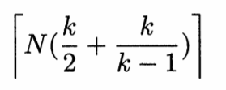
Complexity
THEOREM : (H) is a linear time -approximation algorithm.
The bound is tight, as can be seen by taking as input a graph consisting of N k-cliques. Each clique has k/(k-1) edges and k vertices. The algorithm partitions these edges and vertices in
batches of size k- 1, whereas the optimal cover uses N cliques.

Slide 31
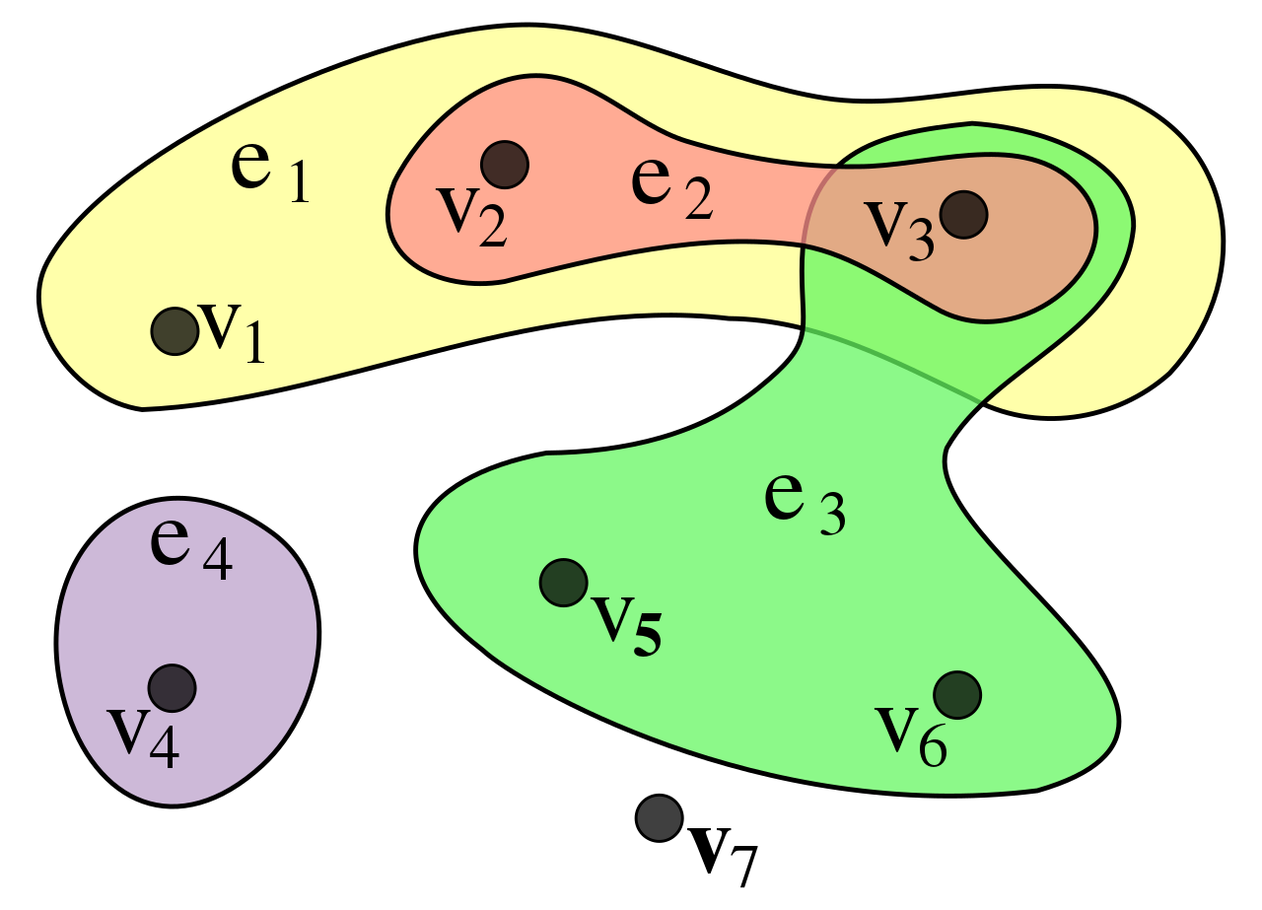
k-Clique Covering of Hyperedges of Size k-1
First let us learn a bit about hypergraphs.
A hypergraph is a generalization of a graph in which an edge can join any number of vertices. In contrast, in an ordinary graph, an edge connects exactly two vertices.
An example of a hypergraph, with
V = {v₁, v₂, v₃, v₄, v₅, v₆, v₇} and
E = {e₁,e₂,e₃,e₄} = {{v₁, v₂, v₃}, {v₂,v₃}, {v₃,v₅,v₆}, {v₄}}.

Slide 32
k-Clique Covering of Hyperedges of Size k-1
Algorithm:
Input: V, E = {E₁, … , E_{m}}.
Step 1: Construct the following undirected graph G(V̅,E̅). Each vertex
represents a hyperedge. Two vertices i and j are connected by an edge if
and only if the corresponding hyperedges i and j form a spanning pair(Two
hyperedges (elements) E_{i} and E_{j} are called a spanning pair if |E_{i} U E_{j}| = k).
Step 2: Find a maximum cardinality matching in G.
Step 3: Put each pair of hyperedges corresponding to the end vertices of a
matching edge obtained in step 2 in a single clique. Put the remaining
unmatched vertices(hyperedges) in separate cliques. Output the collection
of cliques C_{H}.

Slide 33
k-Clique Covering of Hyperedges of Size k-1
V = {a, b, c , d, e}
E = {{a, b, c}, {a, b, d}, {a, c, d}, {b, c, d}, {a, b, e}, {a, c, e}, {b, c, e}}
a,b,c
a,b,e
a,b,d
a,c,e
a,c,d
b,c,e
b,c,d

Slide 34
k-Clique Covering of Hyperedges of Size k-1
a,b,c
a,b,c
a,b,e
a,b,e
a,b,d
a,b,d
a,c,e
a,c,e
a,c,d
a,c,d
b,c,e
b,c,e
b,c,d
b,c,d
Fig: Ideal Case vs Approximation

Slide 35
k-Clique Covering of Hyperedges of Size k-1
Approximation Ratio:
Since for two hyperedges to be packed together, their corresponding vertices must be connected by an edge in G. It suffices to prove the bound for any connected component of G, let us assume that G is connected.
Let t_{i} be the number of hyperedges packed in the ith clique of the optimal solution. These t_{i} hyperedges must form a t_{i}-clique in G. There exists a feasible matching with ⌊t_{i}/2⌋ edges in each of these t_{i}-cliques. If t_{i} is odd, then the number of sets required to cover these nodes is less than or equal to ⌈t_{i}/2⌉. Hence step 3 results in a collection of ∑^{z*}_{i=1} cliques. Let z^{H} = |C^{H}| and z* be the optimal number of cliques.
Since t_{i} <= k, z^{H} <= ∑^{z*}_{i=1} ⌈t_{i}/2⌉ <= z* ⌈k/2⌉.
So the algorithm can be considered an ⌈k/2⌉-approximation.

Slide 36
k-Clique Covering of Hyperedges of Size k-1
Complexity:
The complexity of the algorithm is dominated by the step 2 of the algorithm that is the maximum cardinality matching.
The maximum cardinality matching can be done in O(√VE).
So the complexity of our algorithm can be considered as such.

Slide 37
That’s all. Thank You. Any Questions?

